Slide 1
Grow: Sales Excellence

Slide 2
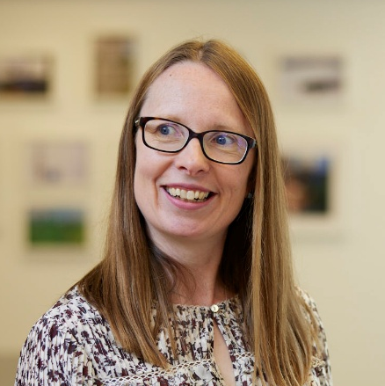
Welcome
Jill Tennant
Group Strategy Director

Slide 3
This team
70 leaders
1,500 years of proven commercial experience
Inspire 4,000 colleagues
£1.5bn of revenue
Stories worth hearing? Absolutely!
Our future? It’s up to us

Slide 4
Agenda
Wednesday, 2nd April
Thursday, 3rd April
08:45 | Welcome & Introduction
09:45 | Sales Excellence
10:00 | Process
12:00 | Lunch
13:00 | People
13:45 | Culture Workshop
15:45 | Fireside Chat with Rich Galgano
16:15 | Closing Remarks
09:00 | Execution
09:45 | Action Plan Workshop
11:30 | Closing Comments

Slide 5
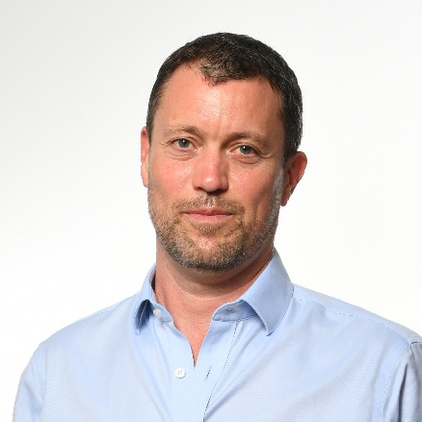
Introduction
Johnny Thomson
Group CEO

Slide 6
Why are we here?
Why are we here?
Celebrate
Confidence
Growth

Slide 7
Celebrate: great fundamentals
Value-add
Quality value-add distribution business
Growth
Significant organic growth potential
People
Passionate, accountable, customer-centric people in a decentralised model
Resilient
Resilience through diversification, customer service & balance sheet
M&A
Successful M&A track record
Financials
Consistent track record of strong financial performance

Slide 8

Celebrate: your brilliant leadership
Driving the Health & Safety culture
Developing capability / Engaging your colleagues
Looked after your customers
Grown your businesses
Developing your business models
Welcomed exciting new businesses
Delivered excellent financial performance

Slide 9
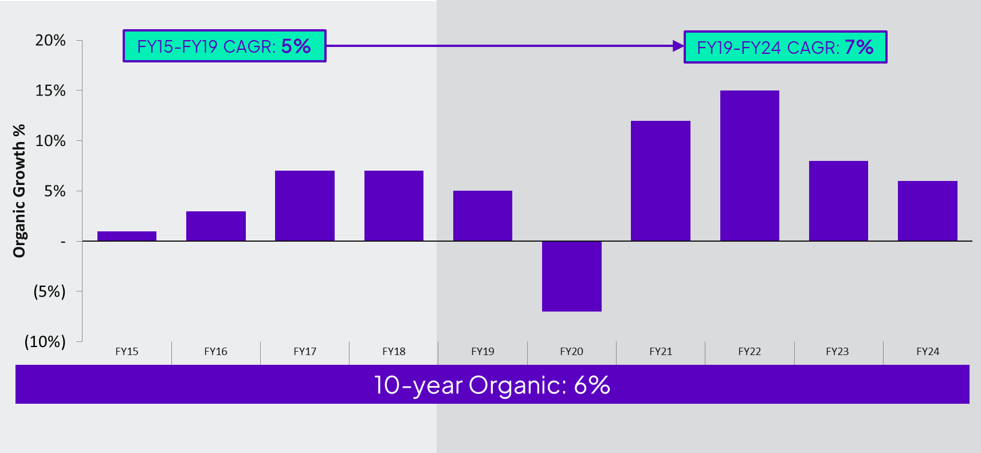
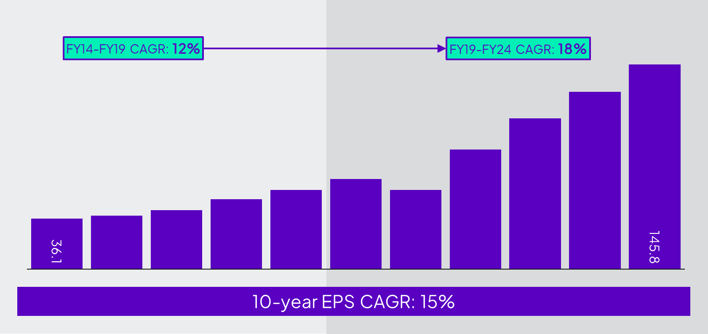
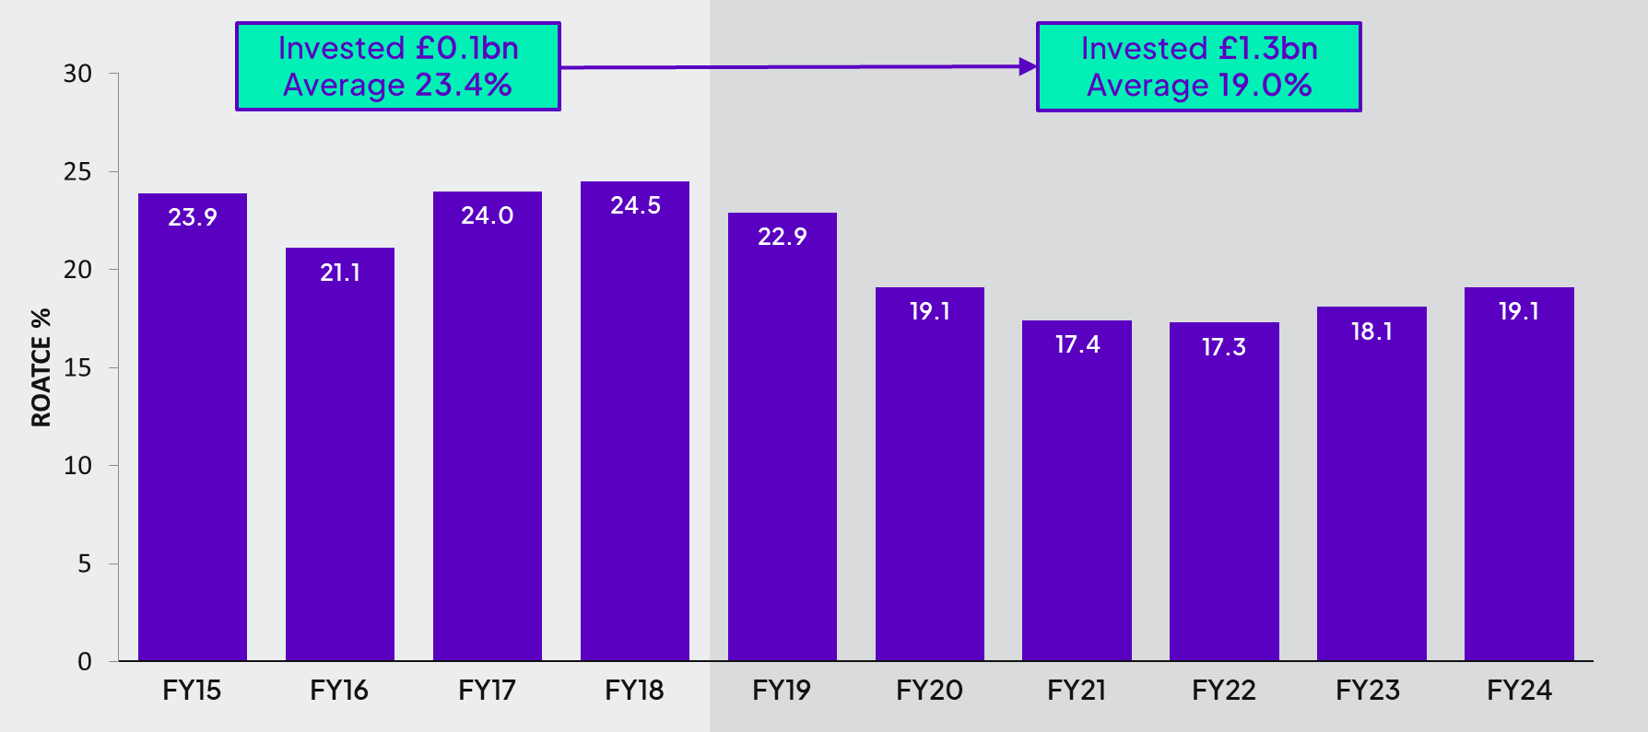
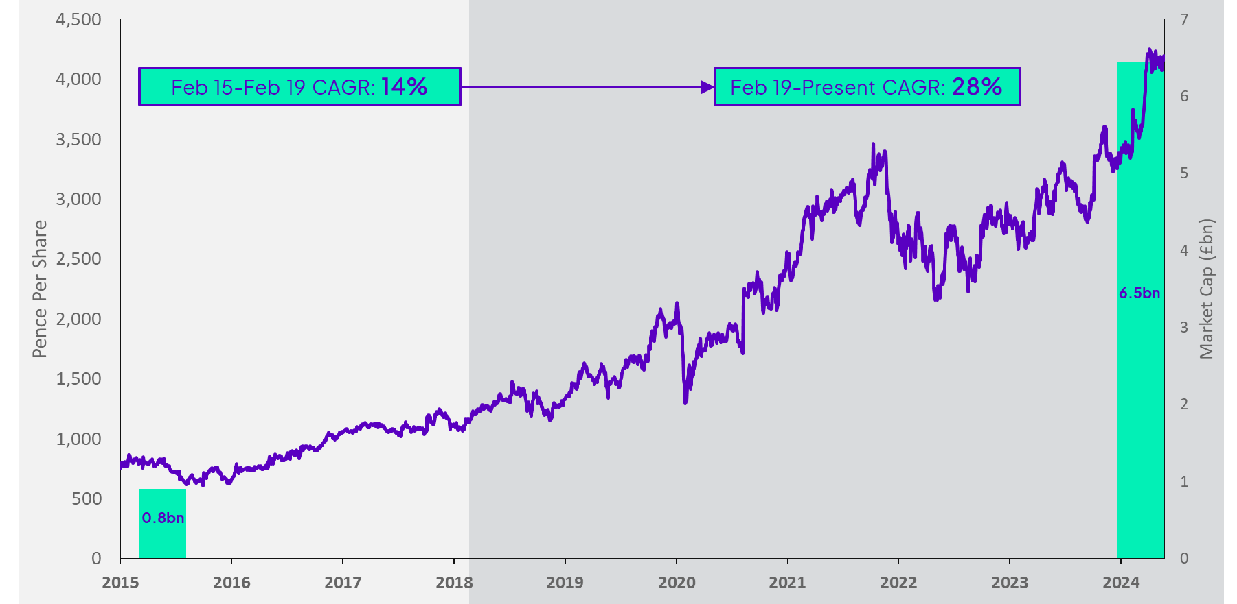
Celebrate: exceptional track record
Organic Growth 10-Year Trend
Adjusted EPS 10-Year Trend (pence)
ROATCE 10-Year Trend
Diploma 10-Year share price history

Slide 10
Consistent key messages for future
2.Building our differentiated business models to excel for customers at scale
1. Delivering on our massive potential for organic growth
Sustainable
Quality
Compounding
3. Developing your brilliant leadership to the next level
Just Started. Be Bold.

Slide 11
Building high quality scalable businesses for sustainable organic growth
GROW
Organic growth in 3 BUCKETS:
Complementary acquisitions to drive future organic growth
End markets
Geographic penetration
Product extension
1
2
3
SCALE
Value-add business model at scale
Powerful decentralised Group at scale
Deliver Value Responsibly

Slide 12
End markets (BUCKET 1)
2024-2030 forecast CAGR*
In vitro diagnostics
7%
Datacentres
9%
Electrification
6%
Aerospace
9%
Industrial automation
6%
Infrastructure
6%
Defence
8%
Energy
8%
Water Management
7%
*Approximate growth rates based on company market data and research

Slide 13



Signiﬁcant “white space” (BUCKETS 2&3)
 |  |  | US | CANADA | UK&I | GERMANY |  | FRANCE |  | SPAIN | OTHER EU |  |  | ANZ
CURRENT Addressable Market | Controls | Wire & Cable
 |  | Interconnect
 |  | Specialty fasteners
 |  | Specialty adhesives
 |  | Industrial automation
 | Seals | Seals
 |  | Gaskets
 |  | Hoses & fittings
 |  | Pumps & valves
 | Life Sciences | IVD
 |  | Medtech
 |  | Scientific
GROWING Addressable Market |  | New product verticals |  |  |  |  |  | Small market share
Market share
Significant
Moderate
Small
White space

Slide 14
Sales Excellence
Sales Excellence
GREAT KEY ACCOUNT MANAGEMENT
GREAT BUSINESS DEVELOPMENT
Relationships
Agile and responsive
Technical know-how
Share of wallet
End market concentrated
Strategic sales leadership
Developing new markets
Broader end market knowledge
Scalable sales processes
Hunter capability and culture
Improving our growth execution

Slide 15
Acquisitions to accelerate organic growth
Core business characteristics
Value add / high gross margin
Organic growth potential
Capable management teams we can back
42
ACQUISITIONS SINCE 2019
Strategic fit
Accelerates one or more organic growth bucket
Brings expertise / capability / culture to open growth
Bolt-on, lift-and-shift
Targets strategic ‘white space’ priorities
TOTAL SPEND £1.3bn
ORGANIC GROWTH 10%
ROATICE 17%
Discipline
Portfolio focus
Management bandwidth
20% ROATCE potential / Covers cost of capital in year 1
Balance sheet leverage < 2x (c. £700m)
5-10
STRATEGIC AMBITION BOLT-ONS EACH YEAR
OCCASIONAL BIGGER DEAL

Slide 16
Developing our differentiated value-add businesses
TO £200m
Business
Strategic, structured leadership
Broader management capability
Seamless, customer-led processes
Technology-enabled; data, automation
Commercial, agile, innovative
Retaining culture with a bigger team
FROM £10m
Business
Hands-on business leader
Individuals wear many hats
Responsive service
Manual
Family feel

Slide 17



Leadership in a bigger de-centralised Group
Life Sciences
Controls
Seals
18 Business
Units
5 Sector
Leaders
Simple
Group
Frameworks
Lean Structure
Skilled Management
Culture/Mood
Life
Sciences
International
Controls
Windy City Wire
International
Seals
North American
Seals
North America
IS Group
Windy City Wire
R&G
Hercules Aftermarket
Europe
Clarendon
DICSA
Ireland / UK
VSP
Nordics
Peerless
M-Seals
Hercules OEM
Australasia
Shoal
Diploma Australia Seals (DAS)
T.I.E.
Techsil
16%
31%
20%
18%
15%
Sector Management
Growth
Scaling
Performance
Sales Excellence
Talent & Mood
Financial Control
DVR
Group

Slide 18
Leadership for Growth

Slide 19
Sustainable Quality Compounding
Ambitious…
…with Discipline
Organic revenue growth is our first priority 10%
Capital-light business model drives strong cash conversion 90%
Total revenue growth, including quality acquisitions 20%
Capital stewardship focused on strong returns (ROATCE) high teens
Value-add drives strong operating margins 20%+
Balance sheet discipline maintains modest debt < 2.0x
Compounding EPS growth 20%
Return to shareholders with a progressive dividend 5%
Double Every 4 Years?

Slide 20
Grow: Sales Excellence
You have grown your businesses really well.
Why the focus?
We are sales businesses…continuously improve out core competence.
Breaking into new markets: Bus Dev and Key Account Management.
Bigger businesses: leading thru process/people, not thru self.
Investment / shareholder perspective.
Key success factors for you….?
Right sales processes
Right sales people
Right sales execution
Sales excellence Plan.

Slide 21
Sales Excellence
Jill Tennant
Group Strategy Director

Slide 22
Why do we need Sales Excellence?

Slide 23
TO
SCALED
BUSINESS
SMALL
FROM
BUSINESS

Slide 24
Delivering bold ambitions
3x
2x
Today

Slide 25

Ideas Inspiration Contacts

Slide 26
Mindset matters
Aware. Learn. Confidence.

Slide 27
Introduction to Sales Excellence
Process
People
Execution
1
Market & Customer Segmentation
3
Leader
8
Funnel & Pipeline Management
2
Sales Process
4
Structure
9
KPIs
5
Capability
10
Performance Routines
6
Incentives
7
Culture

Slide 28
Our customers win and we win
IN SHORT:

Slide 29
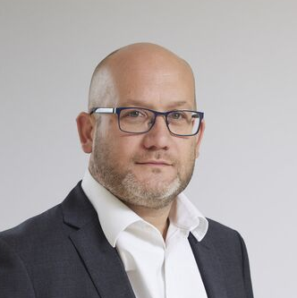
Process
Jill Tennant
Group Strategy Director
David Goode
Sector CEO, International Controls

Slide 30
Process
Process allows us to be strategic and structured in our approach to sales
1
Market &Customer Targeting
2
Sales Process

Slide 31

Process
Market & Customer Targeting
People
Execution
01
Knowing what to sell to whom

Slide 32
Process
Market & Customer Targeting
People
Execution
01
Knowing what to sell to whom
Changing

Slide 33
Process
Market & Customer Targeting
People
Execution
01
Knowing what to sell to whom
Research
Changing

Slide 34
Process
Market & Customer Targeting
People
Execution
01
Knowing what to sell to whom
Research
Changing
Segmentation

Slide 35
Process
Market & Customer Targeting
People
Execution
01
OEM
Contractor
Pains: technical specs, limited time, traceability
Gains: application support, pre-testing, proactive service, confidence
Pains: constant pressure to reduce cost and consolidate suppliers, internal friction between procurement & technical teams
Gains: usage account mgmt, data on spend, help to manage inventory levels
Persona 1
“Bob the
Buyer”
Persona 2
“Erica the Engineer”
Repair Shop
Persona 3
“Mary the Maintenance Manager”
Pains: limited inhouse technical knowledge, frustrated by complex ordering
Gains: tech support, simple repeatable ordering

Slide 36
Process
Market & Customer Targeting
People
Execution
01
Potential matters!
Make sure the customers and markets identified have the potential to deliver against your growth plans.

Slide 37
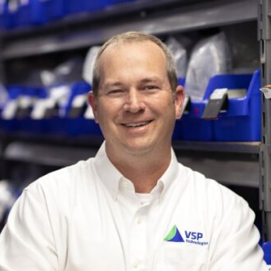
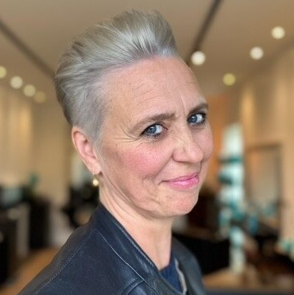
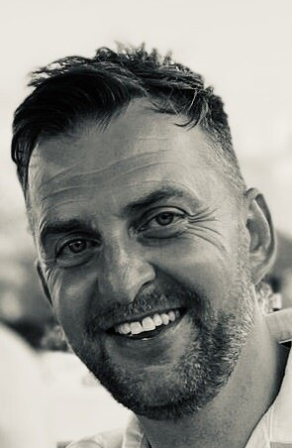
Market & Customer Targeting Panel
David Goode
Moderator
Tyler Ragsdale
President
VSP Technologies
Cindy Nijs
Managing Director
Life Sciences, Nordics
Paul Sanders
Managing Director
Clarendon Specialty Fasteners

Slide 38
Process
Sales Process
People
Execution
02
Every step moves the customer from interest to action

Slide 39
You need Sales Process to scale
02

Slide 40
Process
Sales Process
People
Execution
02
What are the building blocks?
Channel
Lead Generation & Prospecting
Sales Engagement
Price
Fulﬁlment
Account Management & Nurturing

Slide 41
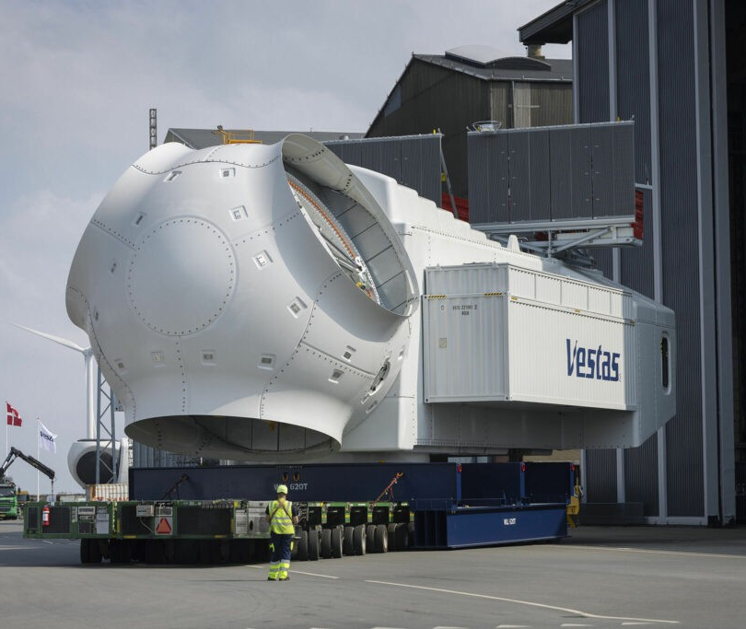
Process
Sales Process
People
Execution
02
Thomas Petersen
Managing Director
M Seals

Slide 42

Process
Sales Process
People
Execution
02
Don Russo
President
Peerless Aerospace

Slide 43
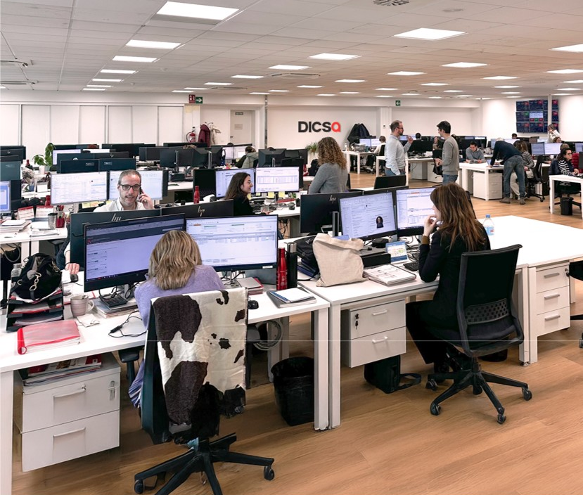
Process
Sales Process
People
Execution
02
Carlos Cordobés
Managing Director
DICSA

Slide 44
Process
Sales Process
People
Execution
02
Use technology wisely

Slide 45
Process
Sales Process
People
Execution
02
Strong foundation, holistic view, remove friction

Slide 46
Know what you want to sell to whom - market & customer targeting
Process
Conclusion
People
Execution
TAKEAWAYS:
Define and implement Sales Process with magic touches

Slide 47
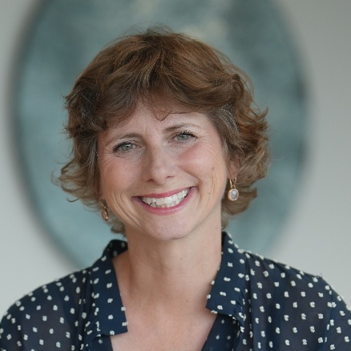
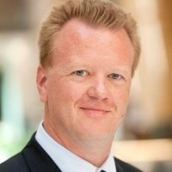
People
Donna Catley
Group HR Director
Peter Soelberg
Sector CEO, Life Sciences

Slide 48
People
3
Leader
4
Structure
5
Capability
6
Incentives
7
Culture

Slide 49
People
Leader
Execution
Process
03
Leading Sales Excellence in Diploma :
Mindset
Customer
Process
People
Execution
Hunger…
to win and to learn

Slide 50
People
Structure
Execution
Process
04
Structure creates clarity and focus

Slide 51
People
Capability
Execution
Process
05
Hire for long-term success
Curiosity
Learning agility
Brilliant storytelling
Will to win
Develop for long-term returns
Coach
Invest in training
Tough decisions

Slide 52


People
Capability
Execution
Process
05
Farming
Reactive
Servicing
Maintaining
Hunting
Proactive
Playing in ‘offence’
Tracking and closing business

Slide 53
People
Capability
Execution
Process
05
Bill Way
CEO
Peerless Aerospace

Slide 54
People
Incentives
Execution
Process
06
Simple
Bold
Results-driven

Slide 55
People
Culture
Execution
Process
07
A winning sales culture across your organisation not just your sales team

Slide 56
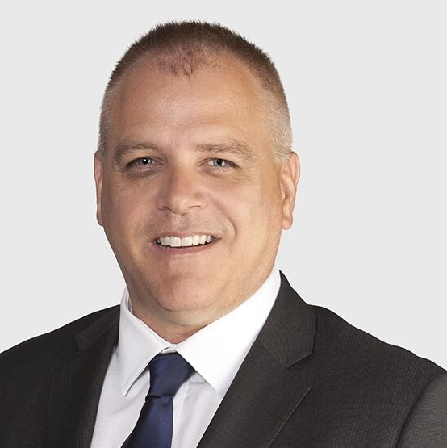
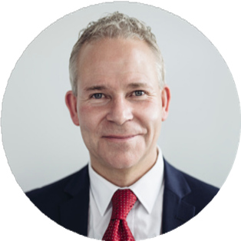
People in Practice Life Sciences ANZ
Shayne Christensen
CEO, Life Sciences ANZ

Slide 57
Structure
Rebalance old or new build: need for change to spread commercial drive and load New build for FY24: alignment with end market customers and suppliers
Capability (mindset)
Activity + technique + confidence KPIs Hiring Performance improvement Tools Monitoring
Culture
Sustainable commercial culture through focus on winning and growing: Meeting cadence incentives
Leadership
Willing to learn Did we do enough Resilience Accountability Competitive Belief and winning mindset Challenger and strong negotiator

Slide 58
Workshop on culture
How do you build a winning culture?
What have you seen work & not work?
Please consider role of sales culture, leader, structure, capability incentives and other

Slide 59
Workshop on culture
Make your way to 15th Floor

Slide 60
People
Conclusion
Execution
Process
Develop sales leadership
Structure to deliver across entire Sales Process
Bold incentives
Build winning teams with hunting capability
Winning sales culture across entire organisation

Slide 61
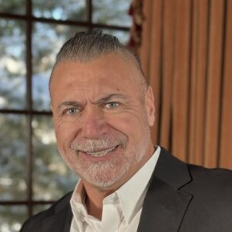
Fireside chat with Rich Galgano
Rich Galgano
Founder, Windy City Wire
Jill Tennant
Group Strategy Director

Slide 62
Day 1 wrap up
Process
People
Execution
1
Market &Customer Targeting
3
Leader
2
Sales Process
4
Structure
5
Capability
6
Incentives
7
Culture

Slide 63
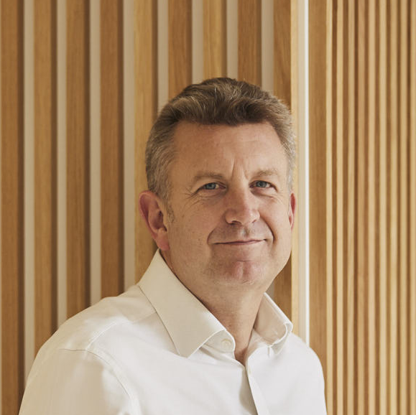
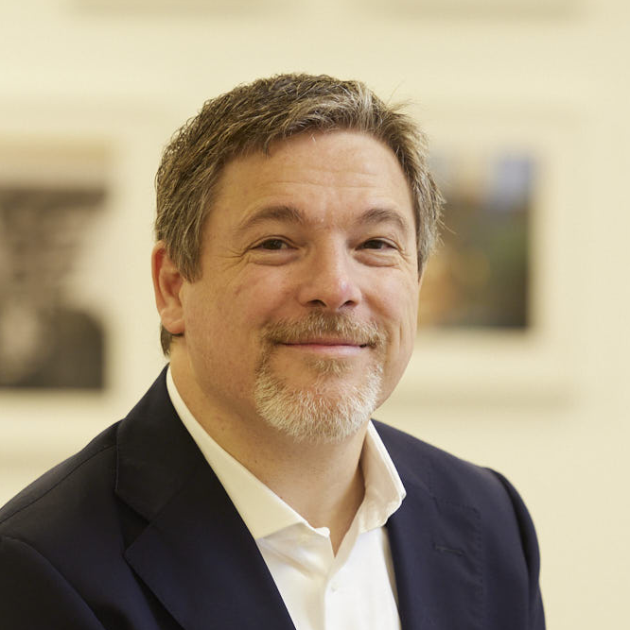
Execution
Chris Davies
Group CFO
Alessandro Lala
Sector CEO, International Seals

Slide 64
Execution
Laser-focused on outcome
8
Funnel & Pipeline Management
9
KPIs
10
Performance Routines

Slide 65
Execution
Funnel & Pipeline Management
Process
People
08
Be brutally honest
Funnel
How many opportunities do we have at each stage of the sales process?
Make it visible
Simple
Pipeline
What opportunities do we have? What stage of the sales process are they at?
Actually helpful

Slide 66

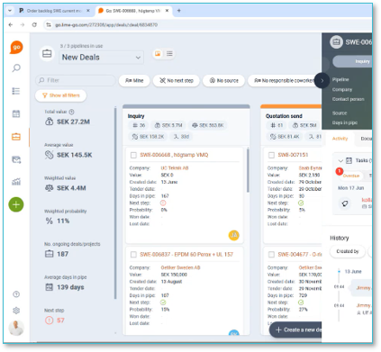


Execution
Pipeline Management
Process
People
08
Pipeline management
Clear overview of where opportunities are sitting in the sales pipeline
Collaboration
When multiple people are working on a single opportunity - the ‘history’ area of the CRM keeps everyone informed

Slide 67
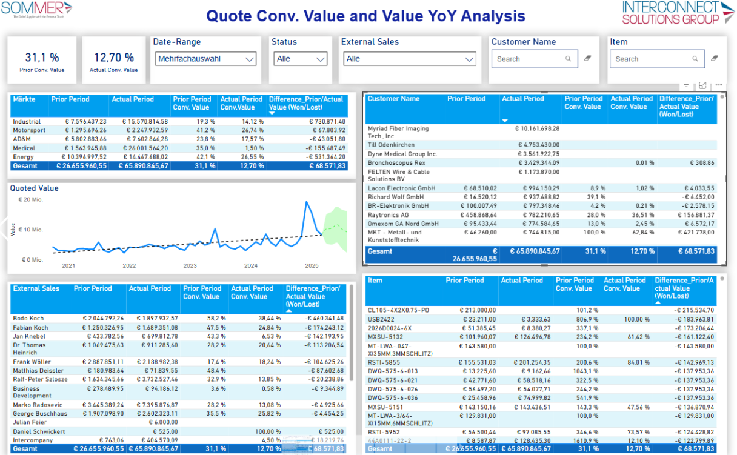
Execution
Funnel Management
Process
People
08
Live data
Detailed analysis
Visualised
Always on hand, also on mobiles etc.

Slide 68

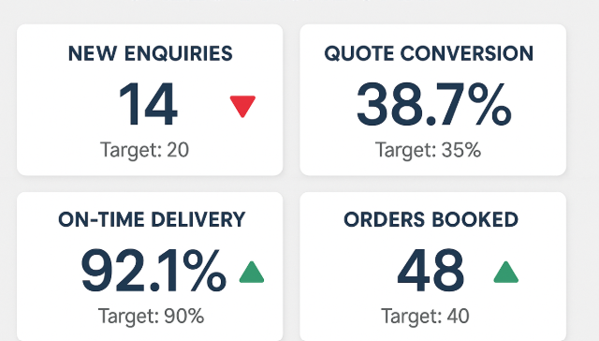
Execution
KPIs
Process
People
09
Sales Dashboard
Handful of KPIs (including conversion)
Real-time / Forward looking
Fed by quality data
Drive the outcome you want
Put it where people can see it

Slide 69
Execution
Performance Routines
Process
People
10
Performance Routines drive consistency
1
2
3
Start at the top and filter down
These are daily and weekly routines
Drive the right outcome (don’t bog people down in paperwork)

Slide 70
Execution
Performance Routines
Process
People
10
Performance Routines drive consistency
Ideas
Relentless quotations follow up
Win/loss reviews
Regular communication with customers (avoid radio silence)
Regular meetings between sales people
For each team member - Re-cap week / objectives for upcoming week

Slide 71
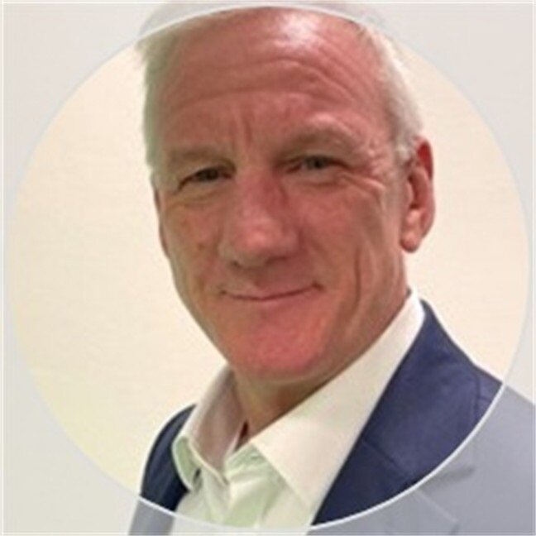
Execution case study Interconnect Solutions Group: Rayfast
Richard Hall
Sales Director, Rayfast

Slide 72
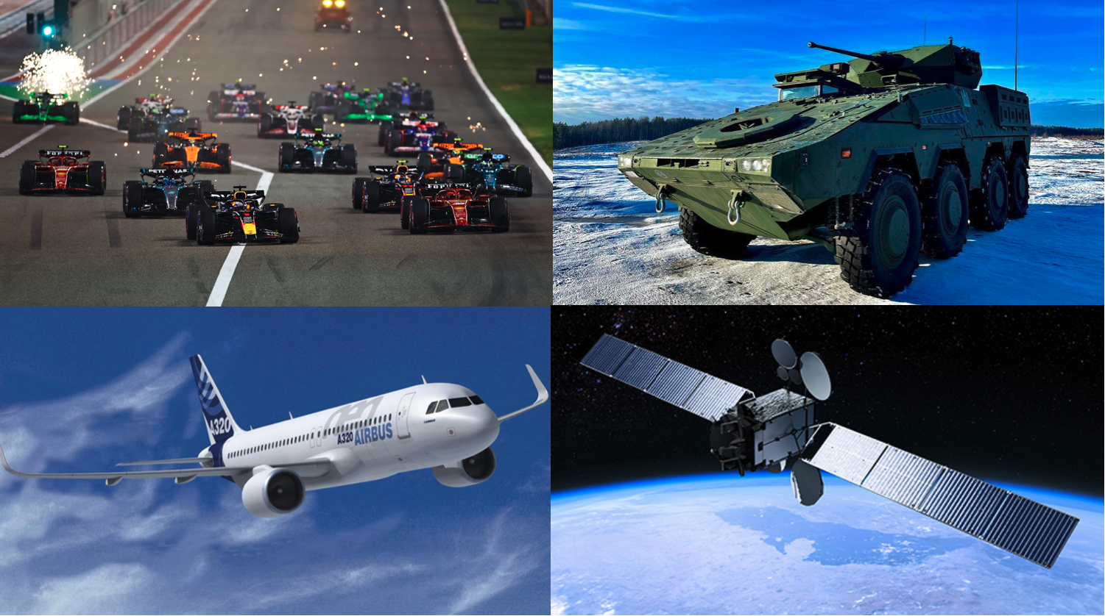

Slide 73
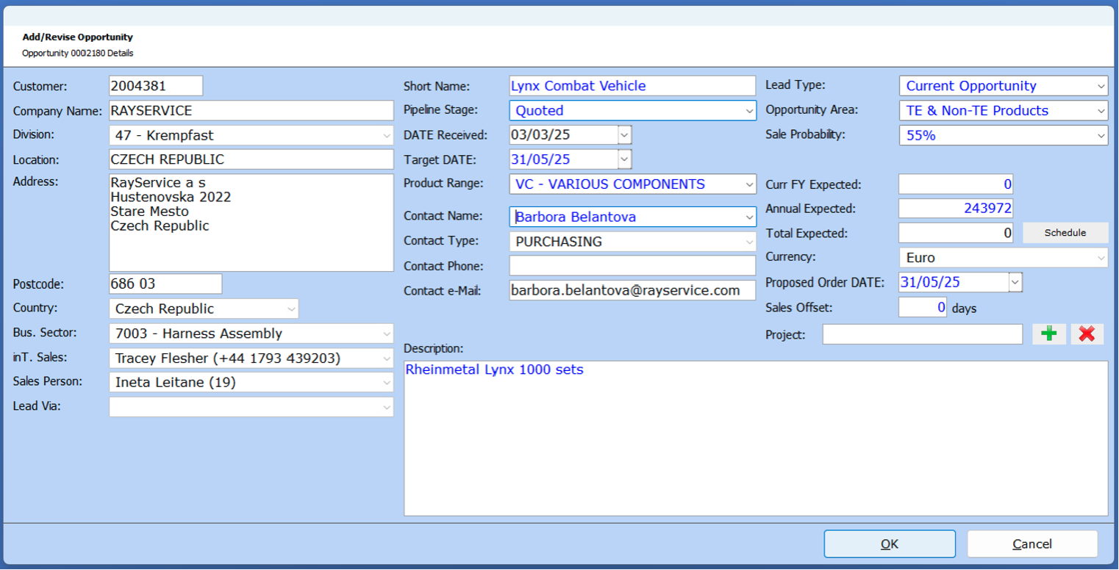

Slide 74
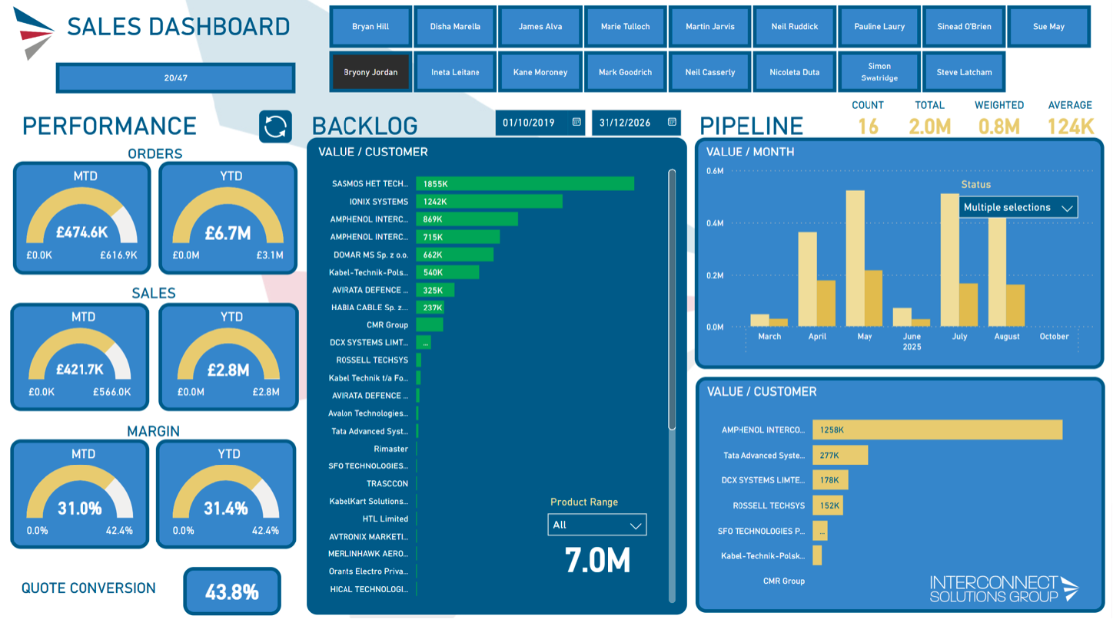

Slide 75
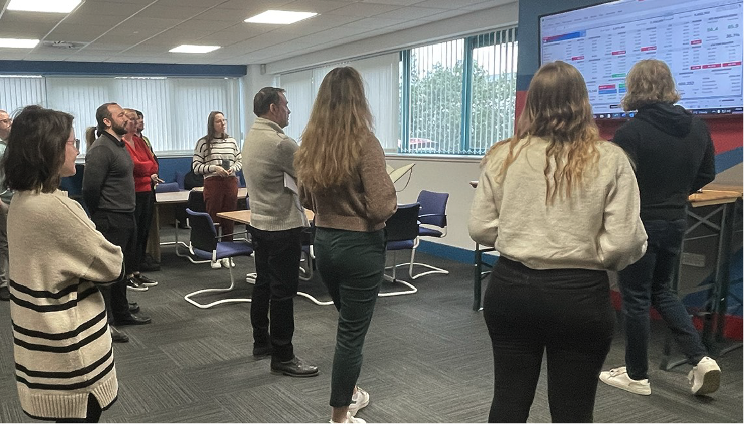

Slide 76
Execution
Conclusion
Process
People
Pipeline/funnel management to drive outcomes
Sales dashboard focused on leading indicators
Daily/weekly performance routines to ensure consistency
Bold pricing for the value we add

Slide 77
Action plan workshop
Present your action plan to the group
Get feedback from the rest of the group
Refine your action plan and commit to it!

Slide 78
Action plan workshop
Make your way to 15th Floor

Slide 79
What’s next?
Jill Tennant
Group Strategy Director

Slide 80
Delivering bold ambitions
3x
2x
Today

Slide 81
Conclusion
Process
People
Execution
1
Market & Customer segmentation
3
Leader
8
Funnel & Pipeline Management
2
Sales Process
4
Structure
9
KPIs
5
Capability
10
Performance Routines
6
Incentives
7
Culture

Slide 82
What’s next?
Over to you

Slide 83
Thank you!
Johnny Thomson
Group CEO

Slide 84
Growth
Plan
Bold

