Slide 1
Customer Personas & Value Propositions

Slide 2
How to use this presentation
This presentation should be used in a workshop with your sales teams.
It could be led by the Sales Director or a sales manager within their team.
The objectives are:
Understand what customer personas are and why they matter
Create personas for real customers based on their traits & business behaviour
Build value propositions for each persona
Develop and practice creating compelling, differentiated value propositions

Slide 3
Agenda
Welcome
Introduction to customer personas
Build your persona: identify tasks, pains & gains
What is their unique value proposition
Match value to persona
Practice the pitch!

Slide 4
Insert bullet points
Welcome
Notes:
Intro to Sales Excellence, connect to Winning Habit of Customer & Market Segmentation.
Why understanding the customer and tailoring value propositions is a differentiator.

Slide 5
What are customer personas?
In B2B we don’t just sell to a company, we sell to different people who want different things.
A realistic profile that represents a typical customer, based on real experiences.
It helps us understand their goals, challenges and how best to serve them.
If we speak their language and solve their problems, then we stand out.
For example:
- A procurement manager might want cost savings and fast quotes
- An engineer might want technical detail and reliability.
- A small business owner might want trusted advice and quick solutions.

Slide 6
Build 2-3 personas from real-life experience:
Build your own personas
Role / title
What do they care about?
How do they buy?
Where do they get information?
What frustrates them about suppliers?

Slide 7
Unique means to them, not just to us:
What is a unique value proposition?
What the customer cares about
What we’re really good at
What competitors can’t easily copy

Slide 8
01
CUSTOMER
VALUE PROPOSITION
PAIN RELIEVERS
How can we reduce or remove their pain?
PAINS
Challenges, risks, obstacles
TASKS
What is the customer trying to get done?
OUR OFFER
How can we help the customer?
FIT
GAIN CREATORS
How can we give the customer what they want?
GAINS
Outcomes the customer wants

Slide 9
Pitch Practice
Practice presenting the unique value proposition to the customer
Focus on tone, clarity and relevance
Optional follow-up: bring a current sales opportunity and revise their pitch with a unique value proposition

Slide 10
Some example personas – you might want to create some real life examples for your business as part of the workshop
Appendix

Slide 11
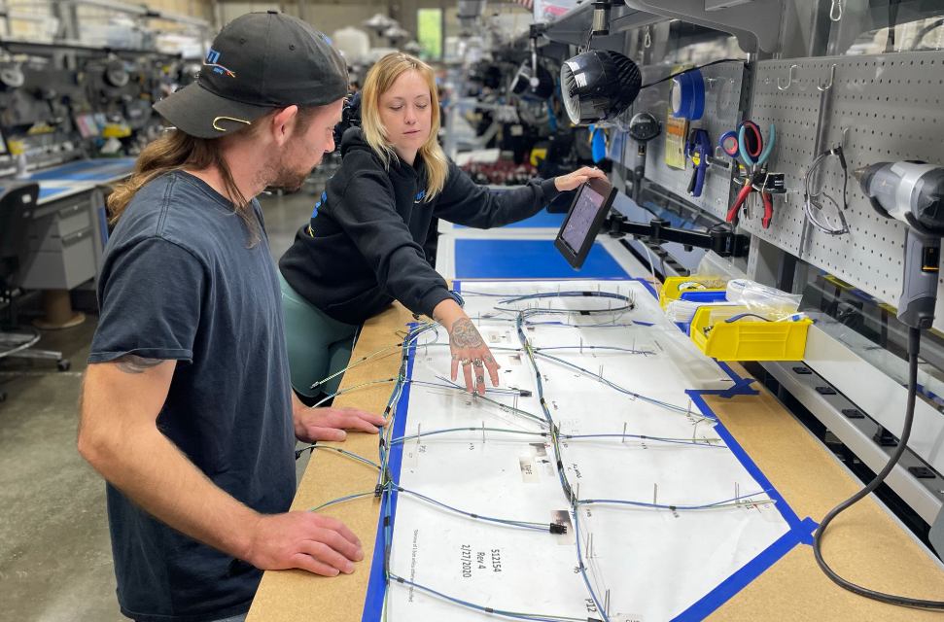
Customer persona: Bob
runs a harness house. Although his business is still small, Bob has won some large new contracts against tough competition.

Slide 12

Customer persona: Helen
is a commodity buyer with 20 years’ experience. She ensures that her production colleagues have what they need, and no more.

Slide 13

Customer persona: Jenny
is an electrical engineer working in a contractor supplying into aerospace. She designs systems, producing interconnection schematics and specifications.

Slide 14

Customer persona: Pete
is Purchasing Manager for a major box-builder supplying into end-users.
He’s new in the company and has the job of evaluating all its key suppliers.

